Slide 1
Face Recognition using PCA
Design a classifier to recognize face image
Team Cortes
August 2017

Slide 2












The problem:
WHO is this?

Slide 3
The flow of data:
Data Collection
Test and training data split
Pick the winning model !
PCA
Modeling
Linear, Guassian, etc.
Evaluation matrix
Black arrow: flow of training data
Red arrow: flow of testing data

Slide 4
Method and Results
Data collection:
Collect face images using opencv package
100 images per class, 6 classes

Slide 5
Method and Results
Test and Training data split
Training data: 75% data (444 samples)
Testing data: 25% data (147 samples)
Randomized samples
Sample counts in each class of training data:
(class_id: sample counts)
0: 68, 1: 74, 2: 73, 3: 79, 4: 80, 5: 70

Slide 6
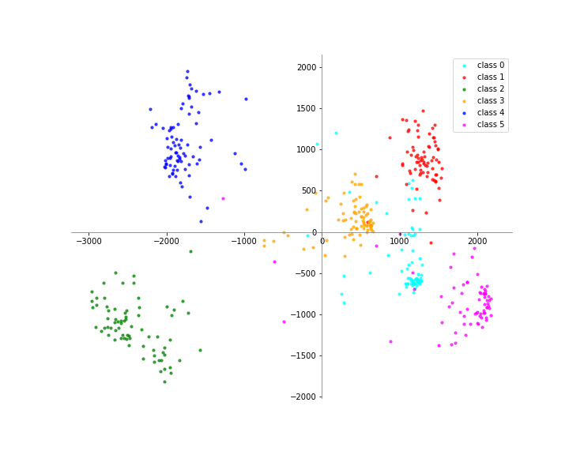
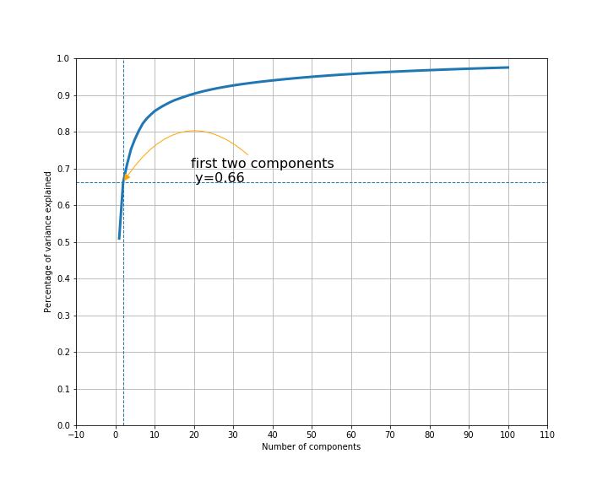
Method and Results
PCA on training data (2500 -> 2 dims)

Slide 7
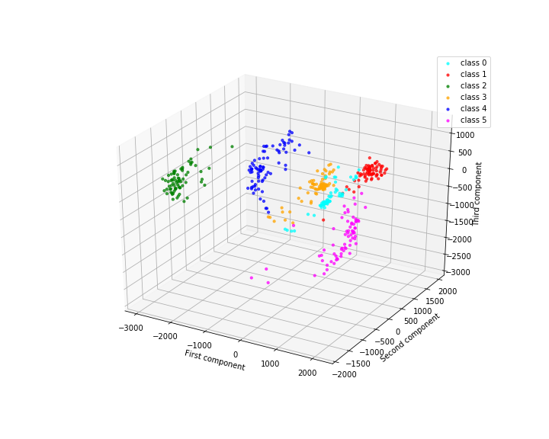
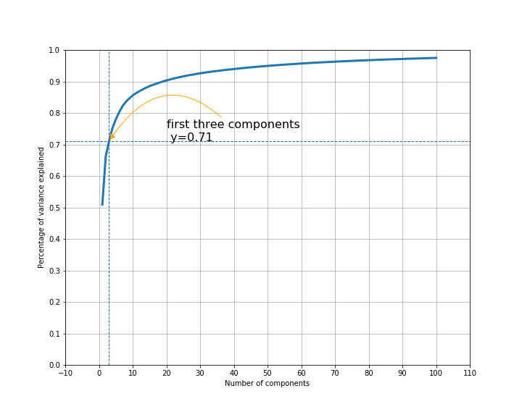
Method and Results
PCA on training data (2500 -> 3 dims)

Slide 8
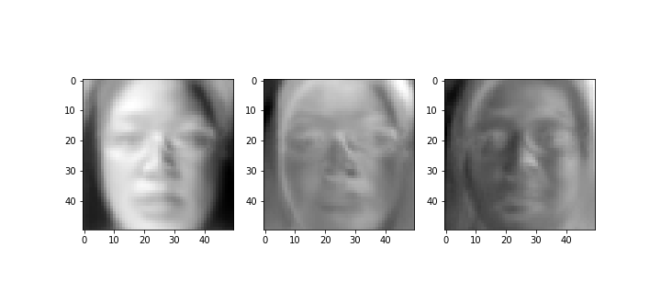
Method and Results
Eigenfaces

Slide 9
Method and Results
Gaussian/Bayesian Model using 2PC
Confusion matrix here…

Slide 10
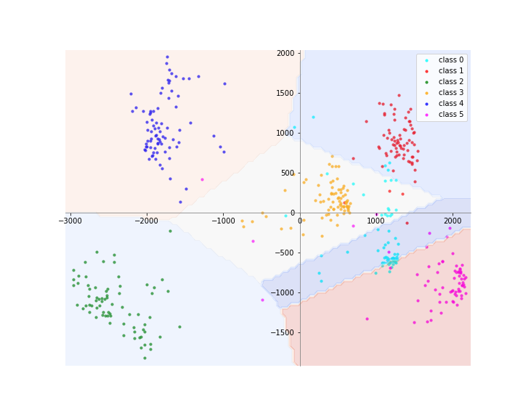
Method and Results
Decision boundary (2D Gaussian)

Slide 11
Method and Results
More models and performance comparison …

Slide 12
Discussion
Factors affect model performance: the effect of lighting on prediction
Caveats: unexpected male and female separation.

Slide 13
Acknowledgements
Team of Cortes
Priyanka Deo
Weiya Jiang
Nicolas Loffreda
Krupa Masilamani
Mukul Sharma
Laura Ye
Special thanks to our teacher:
Shashidhar Sathyanarayana

